Slide 1
Chapter Three
How Securities Are Traded
Copyright © 2014 McGraw-Hill Education. All rights reserved. No reproduction or distribution without the prior written consent of McGraw-Hill Education.

Slide 2
Chapter Overview
How firms issue securities
Primary vs. secondary market
Privately held vs. publicly traded companies
Initial public offerings
Market transactions
Short selling and buying on margin
Rise of electronic trading and globalization of stock markets
Market regulation

Slide 3
How Firms Issue Securities
Primary Market
Market for newly-issued securities
Firms issue new securities through underwriter (investment banker) to public
Secondary Market
Investors trade previously issued securities among themselves

Slide 4
How Firms Issue Securities
Privately Held Firms
Up to 499 shareholders
Middlemen have formed partnerships to buy shares and get around the 499-investor restrictions
Raise funds through private placement
Lower liquidity of shares
Have fewer obligations to release financial statements and other information

Slide 5
How Firms Issue Securities
Publicly Traded Companies
Raise capital from a wider range of investors through initial public offering, IPO
Seasoned equity offering: The sale of additional shares in firms that already are publicly traded
Public offerings are marketed by investment bankers or underwriters
Registration must be filed with the SEC

Slide 6
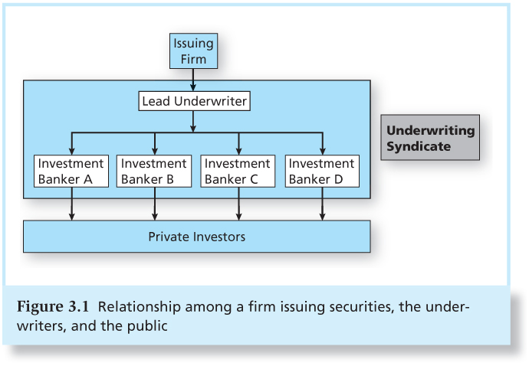
Figure 3.1 Relationship Among a Firm Issuing Securities, the Underwriters, and the Public

Slide 7
How Firms Issue Securities
Shelf Registration
SEC Rule 415: Allows firms to register securities and gradually sell them to the public for two years
Shares can be sold on short notice and in small amounts without incurring high floatation costs

Slide 8
How Firms Issue Securities
Initial Public Offerings
Road shows to publicize new offering
Bookbuilding to determine demand for the new issue
Degree of investor interest in the new offering provides valuable pricing information

Slide 9
How Firms Issue Securities
Initial Public Offerings
Underwriter bears price risk associated with placement of securities:
IPOs are commonly underpriced compared to the price they could be marketed (ex.: Groupon)
Some IPOs, however, are well overpriced (ex.: Facebook); others cannot even fully be sold

Slide 10
How Securities are Traded
Types of Markets:
Direct search
Buyers and sellers seek each other
Brokered markets
Brokers search out buyers and sellers
Dealer markets
Dealers have inventories of assets from which they buy and sell
Auction markets
Traders converge at one place to trade

Slide 11
Bid and Asked Prices
Bid Price
Ask Price
Bids are offers to buy.
In dealer markets, the bid price is the price at which the dealer is willing to buy.
Investors “sell to the bid.”
Bid-asked spread is the profit for making a market in a security.
Asked prices represent offers to sell.
In dealer markets, the asked price is the price at which the dealer is willing to sell.
Investors must pay the asked price to buy the security.

Slide 12
Types of Orders
Market Order:
Executed immediately
Trader receives current market price
Price-Contingent Order:
Traders specify buying or selling price
A large order may be filled at multiple prices

Slide 13
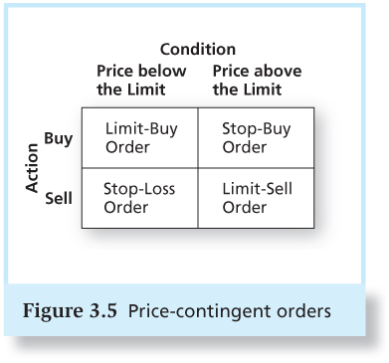
Figure 3.5 Price-Contingent Orders

Slide 14
Trading Mechanisms
Dealer markets
Electronic communication networks (ECNs)
True trading systems that can automatically execute orders
Specialists markets
Maintain a “fair and orderly market”
Have been largely replaced by ECNs

Slide 15
The Rise of Electronic Trading
In the US, the share of electronic trading rose from 16% to 80% in 2000s and was triggered by an interaction of new technologies and new regulations
1975: Elimination of fixed commissions on the NYSE
1994: New order-handling rules on NASDAQ, leading to narrower bid-ask spreads

Slide 16
The Rise of Electronic Trading
1997 and 2001: Reduction of minimum tick size from one-eighth to one-sixteenth, and 1 cent, respectively
2000: Emergence of NASDAQ Stock Market
2006: NYSE is renamed to NYSE Arca after acquiring the electronic Archipelago Exchange
2007: Creation of National Market System (NMS) to link exchanges electronically

Slide 17
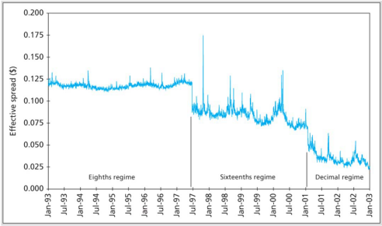
Figure 3.6 The Effective Spread Fell Dramatically as the Minimum Tick Size Fell
(Value-weighted average of NYSE-listed shares)

Slide 18
U.S. Markets
NASDAQ
Lists about 3,000 firms
Originally, NASDAQ was primarily a dealer market with a price quotation system
Today, NASDAQ’s Market Center offers a sophisticated electronic trading platform with automatic trade execution
Large orders may still be negotiated through brokers and dealers

Slide 19
U.S. Markets
The New York Stock Exchange
The largest U.S. stock exchange as measured by the value of the stocks listed on the exchange
Automatic electronic trading runs side-by-side with traditional broker/specialist system
SuperDot : Electronic order-routing system
DirectPlus: Fully automated execution for small orders
Specialists: Handle large orders and maintain orderly trading

Slide 20
U.S. Markets
ECNs
Private computer networks that directly link buyers with sellers for automated order execution over multiple exchanges
Compete in terms of the speed they can offer
Latency: The time it takes to accept, process, and deliver a trading order
Major ECNs include Direct Edge, BATS, and NYSE Arca

Slide 21
New Trading Strategies
Algorithmic Trading
The use of computer programs to make trading decisions
High-Frequency Trading
Special class of algorithmic with very short order execution time
Dark Pools
Trading venues that preserve anonymity, mainly relevant in block trading

Slide 22
New Trading Strategies
Bond Trading
Most bond trading takes place in the OTC market among bond dealers
NYSE Bonds is the largest centralized bond market of any U.S. exchange
Market for many bond issues is “thin” and is subject to liquidity risk

Slide 23
Globalization of Stock Markets
Widespread trend to form international and local alliances and mergers
NYSE acquired Archipelago (ECN), American Stock Exchange, and merged with Euronext
NASDAQ acquired Instinet/INET (ECN), Boston Stock Exchange, and merged with OMX to form NASDAQ OMX Group
Chicago Mercantile Exchange acquired Chicago Board of Trade and New York Mercantile Exchange

Slide 24
Figure 3.8 The Biggest Stock Markets in the World by Domestic Market Capitalization

Slide 25
Trading Costs
Brokerage Commission: Fee paid to broker for making the transaction
Explicit cost of trading
Full service vs. discount brokerage
Spread: Difference between the bid and asked prices
Implicit cost of trading

Slide 26
Buying on Margin
Borrowing part of the total purchase price of a position using a loan from a broker
Investor contributes the remaining portion
Margin refers to the percentage or amount contributed by the investor
You profit when the stock rises

Slide 27
Buying on Margin
Initial margin is set by the Fed
Currently 50%
Maintenance margin
Minimum equity that must be kept in the margin account
Margin call if value of securities falls too much

Slide 28
Example 3.1 Margin Trading: Initial Conditions
Share price $100
60% Initial Margin
40% Maintenance Margin
100 Shares Purchased
Initial Position
Stock $10,000 Borrowed $4,000
Equity $6,000

Slide 29
Example 3.1 Margin Trading: Margin Call
Stock price falls to $70 per share
New Position
Stock $7,000 Borrowed $4,000
Equity $3,000
Margin% = $3,000/$7,000 = 43%

Slide 30
Example 3.2 Margin Trading: Maintenance Margin
How far can the stock price fall before a margin call? Let maintenance margin = 30%
Equity = 100P - $4000
Percentage margin = (100P - $4,000)/100P
(100P - $4,000)/100P = 0.30
Solve to find:
P = $57.14

Slide 31
Short Sales
Purpose
To profit from a decline in the price of a stock or security
Mechanics
Borrow stock through a dealer
Sell it and deposit proceeds and margin in an account
Closing out the position: Buy the stock and return to the party from which it was borrowed

Slide 32
Example 3.3 Short Sale: Initial Conditions
Dot Bomb 1000 Shares
50% Initial Margin
30% Maintenance Margin
$100 Initial Price
Sale Proceeds $100,000
Margin & Equity $50,000
Stock Owed 1000 shares

Slide 33
Example 3.3 Short Sale: Dot Bomb falls to $70 per share
Assets
Liabilities
$100,000 (sale proceeds)
$50,000 (initial margin)
$70,000 (buy shares)
Equity
$80,000
Profit = Ending equity – Beginning equity
= $80,000 - $50,000 = $30,000
= Decline in share price x Number of shares sold short

Slide 34
Example 3.3 Short Sale: Margin Call
How much can the stock price rise before a margin call?
($150,000* - 1000P)/(1000P) = 30%
P = $115.38
* Initial margin plus sale proceeds
Notes:
34

Slide 35
Regulation of Securities Markets
Major regulations:
Securities Act of 1933
Securities Act of 1934
Securities Investor Protection Act of 1970
Self-Regulation
Financial Industry Regulatory Authority
CFA Institute standards of professional conduct

Slide 36
Regulation of Securities Markets
Sarbanes-Oxley Act
Public Company Accounting Oversight Board
Independent financial experts to serve on audit committees of boards of directors
CEOs and CFOs personally certify firms’ financial reports
Boards must have independent directors

Slide 37
Insider Trading
Officers, directors, major stockholders must report all transactions in firm’s stock
Insiders do exploit their knowledge
Jaffe study:
Inside buyers > Inside sellers = Stock does well
Inside sellers > Inside buyers = Stock does poorly

